Slide 1
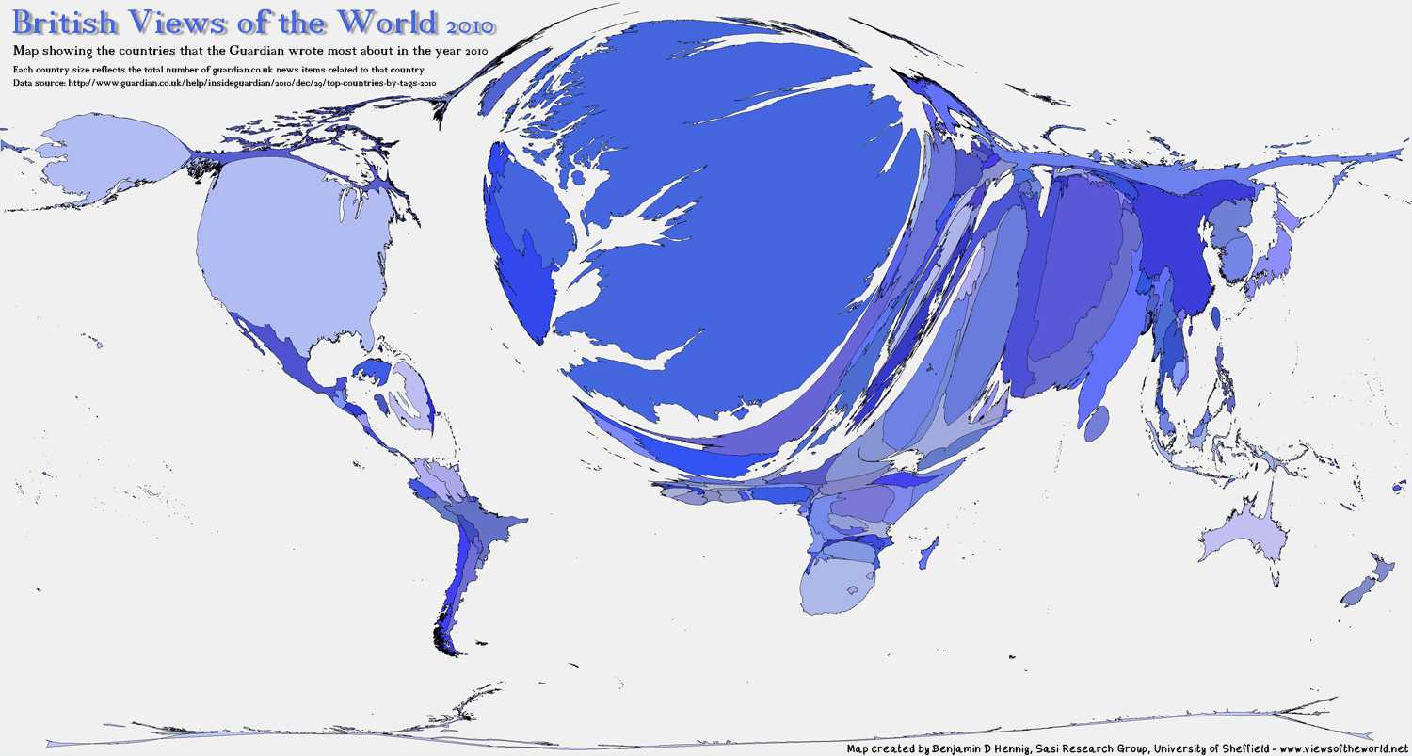
“‘Britain and the World’ in the World of British History”
Guy Ortolano
New York University
September 20, 2018
A map of the world reflecting the number of times the Guardian wrote about each country in 2010.

Slide 2
“Britain & the World”
A bifurcating field? Imperial history across the Atlantic
Current work in modern British history
Issues for consideration in searching and hiring
Further reading
NOTE: The following slides, while hopefully illustrative, are based on rough, back-of-the-envelope categorizations, and should not be cited, circulated, or reproduced without qualification.

Slide 3
A bifurcating field? Imperial history on either side of the Atlantic
British Imperial History
The New Imperial History
“The [post-1945 Cambridge course on imperial history] integrated emergent scholarship on what was then called ‘extra-European history’ in the United Kingdom and would later be called ‘area studies’ in the United States.” Durba Ghosh, AHR, 2012.
Ronald Robinson and John Gallagher, with Alice Denny, Africa and the Victorians: The Official Mind of Imperialism (1961).
Coalesced partly in response to The Oxford History of the British Empire (OUP, 1998-1999).
Less emphasis on trade, economics, warfare, strategies.
More emphasis on culture, language, representations, race.
Kathleen Wilson, The Island Race: Englishness, Empire, and Gender in the Eighteenth Century (2002).

Slide 4
NACBS Report on the State and Future of British Studies in North America (1999):
“Perhaps no issue has been of greater concern to British historians than the decline in employment opportunities in British Studies.”
“Higher Education is much more involved in servicing ethnic diversity, quite properly. Of course these issues are present in domestic British history, but they are more dramatically present in ‘imperial’ history.”
“British historians who are prepared to present themselves as knowledgeable about the world system that arose in large measure around Britain and in response to its actions will be positioned to turn the transition to world history to their advantage.”

Slide 5
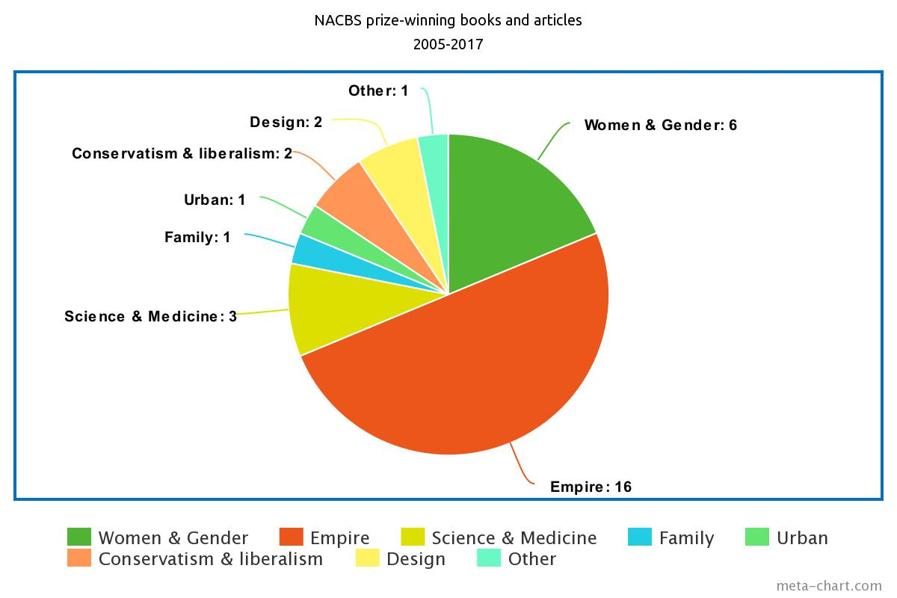
Current work in modern British history: (i) NACBS prize-winning books & articles, 2005-2017
During the preceding 8 years, from 1997 to 2004, just 1 of the 15 prize-winning modern books were on imperial subjects!

Slide 6
Current work in modern British history: (i) NACBS prize-winning books, 2008-2017 (imperial books underlined)
2017: Laura Beers. Red Ellen: The Life of Ellen Wilkinson, Socialist, Feminist, Internationalist; Mark Doyle. Communal Violence in the British Empire: Disturbing the Pax.
2015: Seth Koven. The Match Girl and the Heiress.
2014: Deborah Cohen. Family Secrets: Shame and Privacy in Modern Britain.
2013: Jim Epstein. Scandal of Colonial Rule: Power and Subversion in the British Atlantic during the Age of Revolution; Jordanna Bailkin. The Afterlife of Empire.
2012: Theodore Koditschek. Liberalism, Imperialism, and the Historical Imagination.
2011: Elaine Hadley. Living Liberalism: Practical Citizenship in Mid-Victorian Britain.
2010: Ritu Birla. Stages of Capital: Law, Culture and Market Governance in Late Colonial India.
2009: Richard Price. Making Empire: Colonial Encounters and the Creation of Imperial Rule in Nineteenth-Century Africa.
2008: Sharon Marcus. Between Women: Friendship, Desire and Marriage in Victorian England.

Slide 7
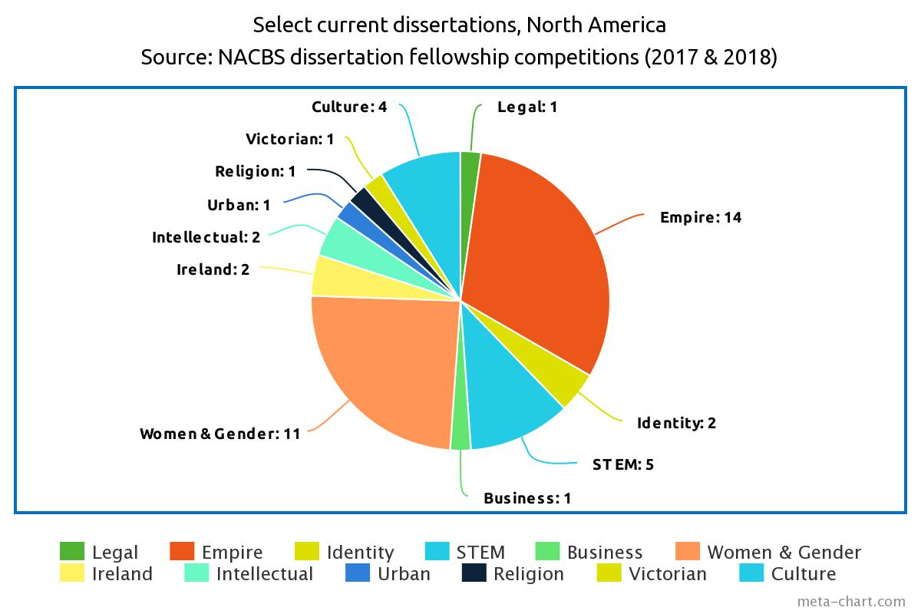
Current work in modern British history: (ii) Current North American dissertations

Slide 8
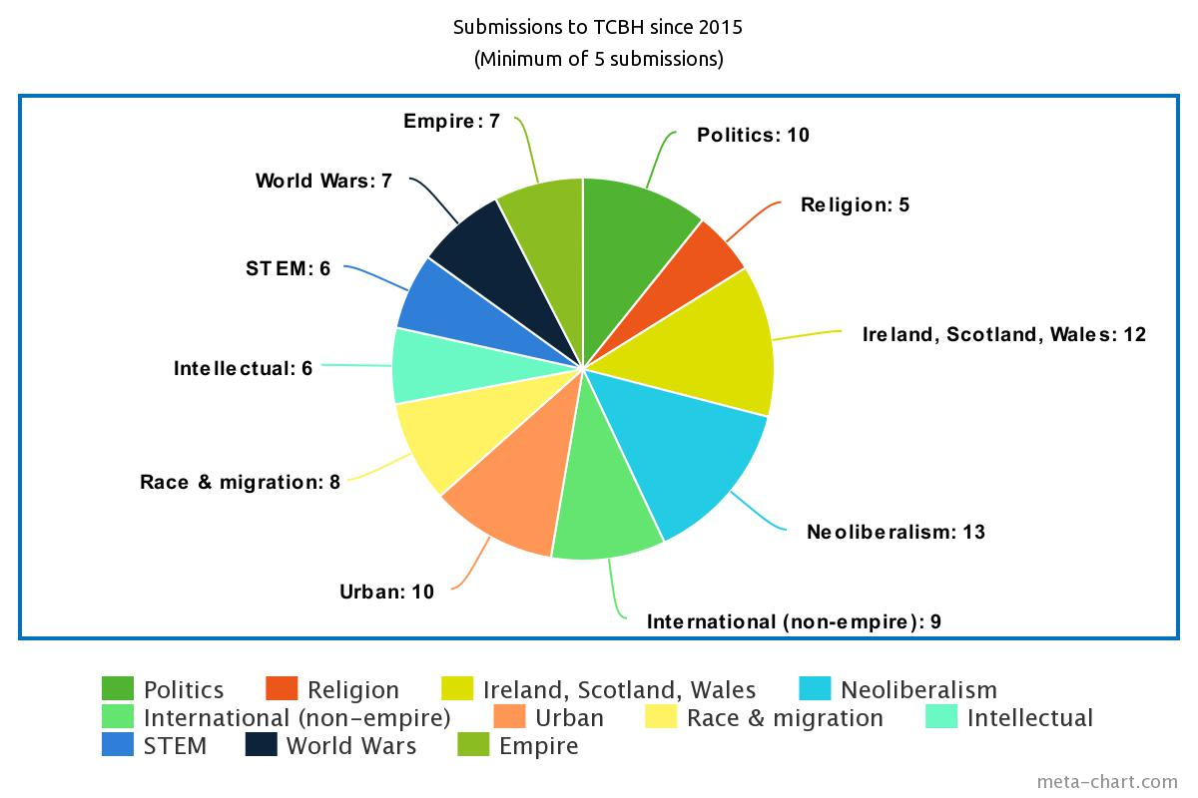
Current work in modern British history: (iii) TCBH article submissions (80% UK-based in 2017)

Slide 9
Current work in modern British history: (iv) Imperial history
A rich field: Topics under “imperial history” among current NACBS dissertations include slavery (x2), legal history (x2), commodities (x2), violence, settler colonialism, political economy, comparative empires, commemoration, the history of medicine, Scotland.
Exemplary concentrations include:
Empire’s impact upon metropolitan Britain: Jordanna Bailkin, The Afterlife of Empire (2012).
Settler colonialism: James Belich, Replenishing the Earth (2009).
Commodity studies: Erika Rappaport, How Tea Shaped the Modern World (2017).
Slavery and the British Empire: Catherine Hall et al., The Legacies of British Slave-Ownership (2014).

Slide 10
Issues for consideration in searching and hiring: (i) Where is the field of British history now?
UK:
US:

Slide 11
Issues for consideration in searching and hiring: (ii) Where is the field of British history going?
Recent “Britain & the World” searches at the University of Bristol and the University of York . . .
. . . but of Bristol’s 43 historians, 22 study British and Irish history.
. . . and of York’s 50+ historians, 25 study British and Irish history.
Essential new field, or the 25th priority?

Slide 12
Issues for consideration in searching and hiring: (iii) What gets left out?
STEM
Ireland
Women & gender
. . . and all the brave oddballs who, against marketplace logic and the promise of prizes, dare to work on something other than empire!

Slide 13
Issues for consideration in searching and hiring: (iv) What is the most intellectually diverse pool?

Slide 14
Conclusions and considerations:
Intellectually diverse, established and predominant in North America, arguably with a growing profile in Britain . . .
But in important ways a limiting framework, one that exacerbates a division between the US and UK fields, and that can marginalize not only important work in other areas, but also some of the most adventurous North American Ph.D. students.

Slide 15
Further reading:
Peter Stansky, Nicoletta Gullace, Cynthia Herrup, Dane Kennedy, Brian Levack, Jeffrey Reznick, and Martin Wiener, NACBS Report on the State and Future of British Studies in North America (1999): http://www.nacbs.org/archive/nacbs-report-on-the-state-and-future-of-british-studies
Durba Ghosh, “Another Set of Imperial Turns?” American Historical Review 117:3 (2012): 772-793.
James Vernon, “The History of Britain Is Dead; Long Live a Global History of Britain,” History Australia 13:1 (2015): 19-34.
Susan Pedersen, “Money, Space, and Time: Reflections on Graduate Education,” Twentieth Century British History 21:3 (2010): 382-396.

